Slide 1

Gis mini-course
Day 3: Basics of Spatial Statistics

Slide 2
overview
Spatial dependence
Moran’s I
Spatial Weights Matrix
Local Moran/ Local Indicators of Spatial Association (LISA)

Slide 3
Spatial dependence
First Law of Geography: “Everything is related to everything else, but near things are more related than distant things.“¹
Spatial dependence refers to the degree of spatial autocorrelation between independently measured values observed in geographical space.²
Spatial dependence violates linear regression assumption of independence of dependent variable.

Slide 4
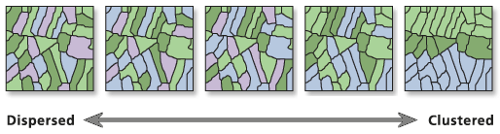
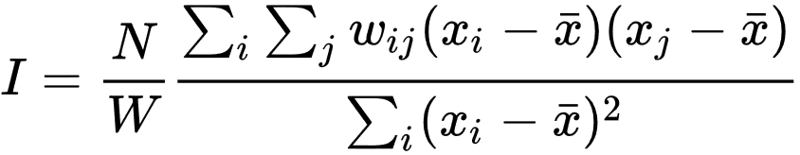
Moran’s I
Global measure of spatial autocorrelation (-1 to 1)
I = 0
Complete Spatial
Randomness
I = -1
Uniform Distribution
I = 1
[3]

Slide 5


N is the total number of spatial units i and j.
X is the variable of interest
is the mean of the variable of interest
is your weight matrix with 0 on the diagonals (see slide 11 on what this looks like)
W is a sum of all spatial weights wij

Slide 6
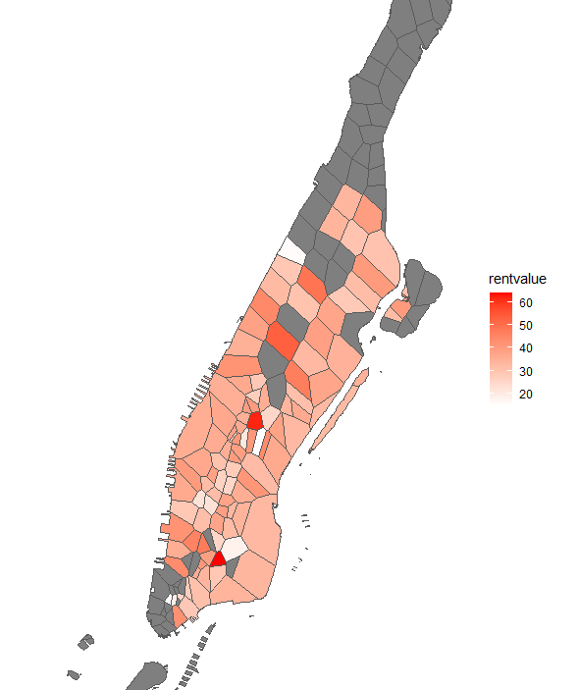
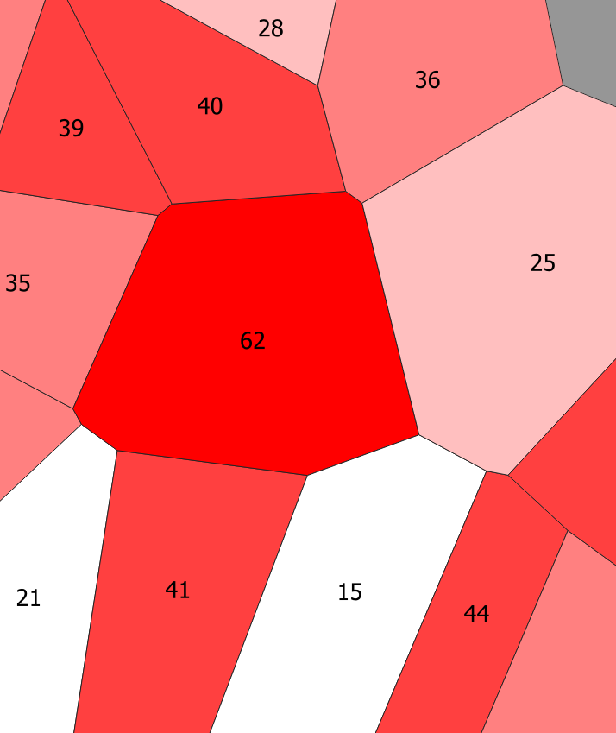
How moran’s I works
How do local neighborhoods compare to global measure?
Mean = 34
Shape with 62 deviates by 28
Shape with 40 deviates by 6
Their cross product would be 28 x 6 = 168

Slide 7
How moran’s I works
62 has a deviation of 28
15 has a deviation of -19
Cross product is -532
Lots of low and high values together will produce significant Moran’s I
If crossproducts balance each other, then it produces values close to zero or spatial randomness
Find a full explanation here from ESRI

Slide 8
Hypothesis testing
The Null Hypothesis is that the data exhibits complete spatial randomness
If Moran’s I p-value is non-significant, then it suggests the data may be “randomly” distributed
If Moran’s I p-value is positive and the z-score is positive, then it suggests that the data is significantly clustered and the null hypothesis can be rejected
If Moran’s I p-value is positive and the z-score is positive, then it suggests that the data is significantly clustered and the null hypothesis can be rejected

Slide 9
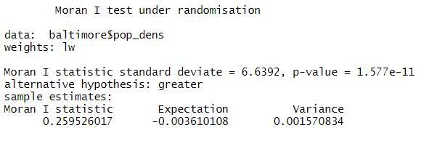
Z-score? – Standard Deviate
The Z-score is the number of standard deviations that a statistic is away from its expected mean given many simulated permutations.
In R and the spdep package, the Z-score is reported as the Standard Deviate
If you look at the summary of your test you will see both the standard deviate score, p-value, and Moran I statistic which should help you evaluate spatial autocorrelation

Slide 10
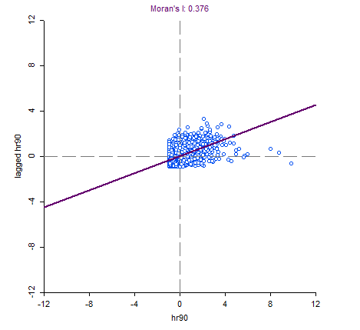
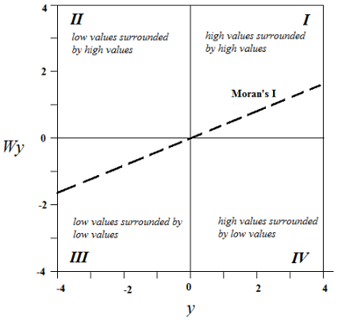
Moran scatterplot
Notes:
A high moran’s I will be the slope that runs through many clustered points along that line
II and IV quadrants will tend to reduce Moran’s I because values will not be clustered

Slide 11
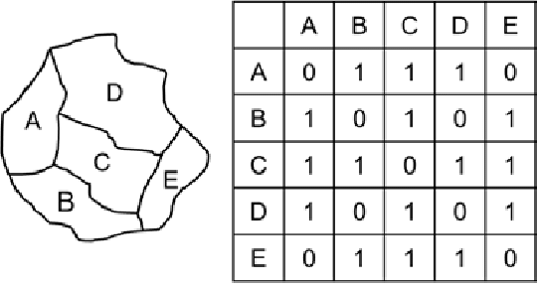
Spatial neighbors/ Spatial weights matrix
Space and adjacency is determined by constructing a spatial weights matrix
Much like a correlation matrix, but values are typically 1 (if neighboring) or 0 (not neighboring)
[4]

Slide 12
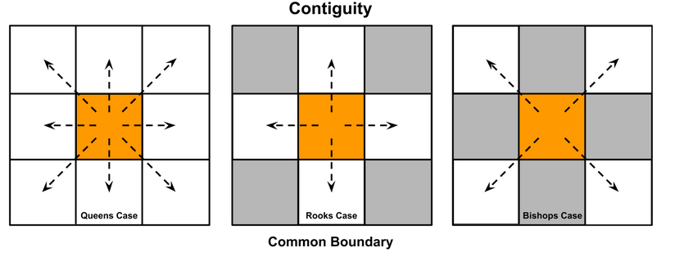
Rook and queens case neighbors
Neighbors can be determined in several different ways
Rooks Case: Centroid to centroid on 4 principal axes
Queens Case: Centroid to centroid on 8 axes (includes corners)
Bishops Case: Never seen this used!
[5]

Slide 13
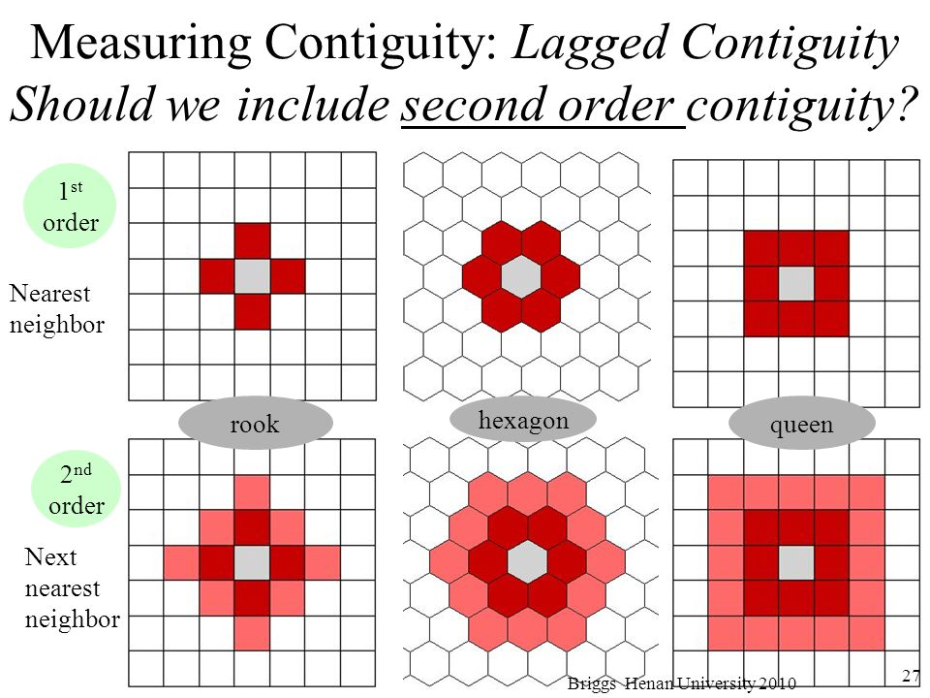
1st and 2nd order contiguity
[6]
Notes:
Whether you include 2nd (or more) order contiguity depends on the data.
If the spatial scale of the data is small (short distance between features) then it might make sense.
For instance, if each cell was a house, the price of the house would be determined by the houses around it far beyond the first contiguity!

Slide 14
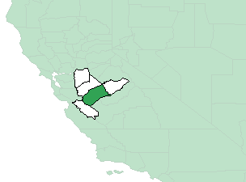
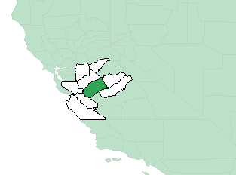
K Nearest neighbors
Another way to determine neighbors is to select the nearest k neighbors
Nearest is determined by feature centroids, not contiguity
The data should determine what k is
8+ neighbors is usually ideal for Moran’s I
No feature should have 0 or all features as neighbors!
K = 4
K = 8

Slide 15
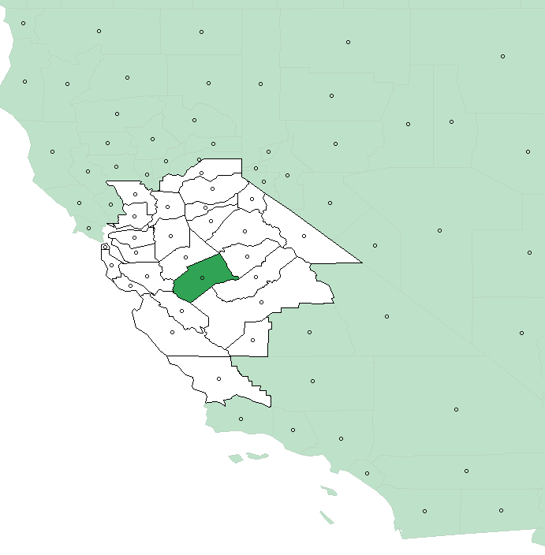
Distance
Lastly, we can also use a distance bandwidth to choose neighbors that are within a certain distance of a feature

Slide 16
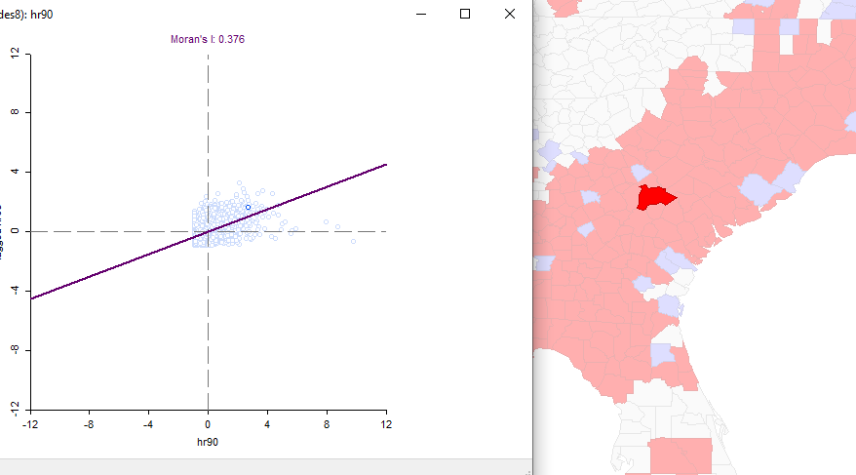
Local indicators of spatial autocorrelation
Moran’s I is a global measure but what about local?
LISA breaks down the global measure into local clusters of spatial autocorrelation
Where are like values clustering?

Slide 17
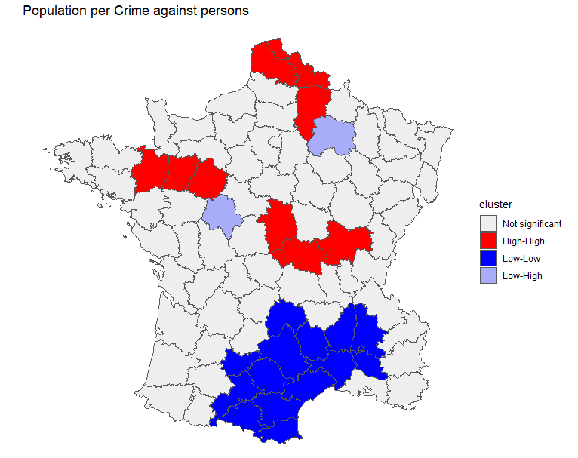
Rgeoda package
Allows use of some GeoDa functions but not all
Easily perform LISA and some other functions in R
Works with sf package

Slide 18
References
[1] Tobler W., (1970) "A computer movie simulating urban growth in the Detroit region". Economic Geography, 46(Supplement): 234–240
[2] Crawford, T.W., 2009. Scale Analytical, in: Kitchin, R., Thrift, N. (Eds.), International Encyclopedia of Human Geography. Elsevier, Oxford, pp. 29–36. https://doi.org/10.1016/B978-008044910-4.00399-0
[3] https://desktop.arcgis.com/en/arcmap/10.3/tools/spatial-statistics-toolbox/spatial-autocorrelation.htm
[4] Bi, Youyi & Xie, Jian & Sha, Zhenghui & Wang, Mingxian & Fu, Yan & Chen, Wei. (2018). Modeling Spatiotemporal Heterogeneity of Customer Preferences in Engineering Design. 10.1115/DETC2018-86245.
[5] https://chrismgentry.github.io/Spatial-Regression/

Slide 19
References continued
[6] https://spatialanalysis.github.io/workshop-notes/spatial-autocorrelation.html
Further Reading:
Anselin, L. (1995). "Local indicators of spatial association – LISA". Geographical Analysis, 27, 93-115.

